Slide 1
AMAZING ENERGY OIL & GAS
DECEMBER 2018 LD MICRO

Slide 2
FORWARD LOOKING STATEMENTS
This presentation of Amazing Energy Oil and Gas, Co. (“AMAZ” or “Company”) contains forward-looking statements within the meaning of the federal securities laws. Any statements that express or involve discussions with respect to predictions, expectations, beliefs, plans, projections, objectives, and goals, assumption of future events or performance are not statements of historical fact and may be deemed “forward-looking statements.” Forward-looking statements can often be identified by the use of words such as “may,” “will,” “estimate,” “intend,” “continue,” “believe,” “expect,” “plan,” “propose,” “projected,” “seek,” or “anticipate,” although not all forward-looking statements contain these or other identifying words. Forward-looking statements are based on expectations, estimates and projections at the time the statements are made that involve a number of risks and uncertainties which could cause actual results or events to differ materially from those presently anticipated. Such forward-looking statements relate to, among other things: expected revenue, cash flow and earnings growth; estimates regarding oil and gas reserves, future oil and gas prices and present values of such reserves; strategies and timelines for growth of the Company’s business; and projected capital expenditures. These statements are qualified by important factors that could cause the Company’s actual results to differ materially from those reflected by the forward-looking statements. Such factors include, but are not limited to: the Company’s ability to locate and acquire suitable interests in oil and gas properties on terms acceptable to the Company; the Company’s ability to obtain working capital as and when needed on terms acceptable to the Company; the ability to integrate, manage and operate acquired oil and gas properties; the ability of the Company to build and maintain a successful operations infrastructure and to retain key personnel; possible insufficient cash flows and resulting illiquidity; government regulations; lack of diversification; political risk, international instability and the related volatility in the prices of oil and/or natural gas; increased competition; stock volatility and illiquidity; the Company’s potential failure or inability to implement fully its business plans or strategies; general economic conditions; and the risks and factors described from time to time in the Company’s offerings, reports and filings with the U.S. Securities and Exchange Commission (the “SEC”). The Company cautions readers not to place undue reliance on any forward-looking statements. The Company does not undertake, and specifically disclaims any obligation, to update or revise such statements to reflect new circumstances or unanticipated events as they occur.
The information contained in this presentation is provided by the Company for informational purposes only and does not constitute an offer to buy or an invitation to sell securities of AMAZ or other financial products. The information contained herein is not investment or financial product advice and is not intended to be used as the basis for making an investment decision. The views, opinions and advice provided in this presentation reflect those of the individual presenters, and are provided for information purposes only. The presentation has been prepared without taking into account the investment objectives, financial situation or particular needs of any particular person. No representation or warranty, expressed or implied, is made as to the fairness, accuracy, completeness or correctness of the information, opinions and conclusions in this presentation. To the maximum extent permitted by law, neither the Company nor any of its respective directors, officers, employees or agents, nor any other person accepts any liability, including, without limitation, any liability arising out of fault or negligence, for any loss arising from the use of the information contained in this presentation.
Cautionary Note to Investors Concerning Oil and Gas Reserve Estimates: The SEC permits oil and gas companies, in their filings with the SEC, to disclose only “Proved” reserves that a company has demonstrated by actual production or conclusive formation tests to be economically and legally producible under existing economic and operating conditions. the company uses certain terms in this presentation such as “Probable” or “Possible” oil and gas reserves that are not recognized by the SEC and the Company cannot include them in its SEC filings. Investors are urged to consider closely the disclosure in the Company’s SEC filings which can be obtained at www.sec.gov.
2

Slide 3
MISSION STATEMENT
Amazing Energy Oil and Gas, Co. (OTCQX: AMAZ) is a Plano, Texas-based oil and gas exploration, development, and production company with current operations in the Permian Basin of West Texas recognized as the top producing oil basins in North America. Founded in 2009, the experienced management team has aggressively sought to acquire the rights to 70,000 acres in Pecos County in the Permian Basin with development opportunities for future years. AMAZ’s management understands what is required to build an oil and gas company from the ground up, having successfully done so on more than one occasion. With over 200 years of combined experience in the oil and gas industry coupled with new technological advancements, careful geological evaluation and reservoir engineering and long-established industry relationships, AMAZ has the components in place to build another profitable and successful public oil and gas company.
3

Slide 4
AMAZING ENERGY
A TEXAS PURE-PLAY E&P
4

Slide 5
OVERVIEW: AMAZING ENERGY
Midland and Delaware Basins:
Hold rights within 70,000 contiguous acres in North America’s most sought after oil and gas region
Adjacent to the prolific, Yates Oilfield, which has a cumulative production over 1.6 billion barrels of oil
Pecos
County:
Attractive drilling requirements
Continuous drilling obligations can be “banked” – Currently May, 8, 2019
$200 to $300/acre bonus payable at time of leasing
Resource
Potential:
Amazing’s assets have stacked pay zones that hold deep vertical and horizontal potential
$15.3 billion worth of probable production according to a Baker Hughes report for property March 2017
Management &
Consulting:
<200 years of combined experience in O&G operations and admin.
<100 years of combined Wall Street PubCo experience
Senior management has held positions at Exxon, Hercules Oil Company, Rampart Energy, and Lexington Resources Inc.
5

Slide 6
OVERVIEW: STRATEGY
STRAT:
CORE ASSET ALLOCATION: CURRENTLY HAS A PROGRAM TO DRILL, COMPLETE, AND/OR RE-WORK 3 WELLS PER MONTH BY SUMMER 2019
STRAT:
DATA & ANALYSIS LEADS TO DERISKING: STARTED SCIENCE AND FORMATION AND PRODUCTION TESTING – OVER $1 MILLION DEPLOYED IN 2018
STRAT:
BUSINESS DEVELOPMENT: DEVELOPMENT OF ADDITIONAL JOINT VENTURES
STRAT:
PROTECTING SHAREHOLDER VALUE: ACCESS TO DRILLING PARTNERSHIP PROGRAMS TO FUND GROWTH WITHOUT STOCK DILUTION
6

Slide 7
OVERVIEW: RECENT DEVELOPMENTS
September 2017
January 2018
March 2018
Appointed two new members to its Board of Directors and strengthened controls
Began IR awareness program for company
Announced the completion of a multi-stage frac on WWJD #23 well in Queen A and B
Announced the successful drilling, logging, coring and cementing casing WWJD #31
Announced a Joint Venture
Term Sheet agreement with
Encore Natural Resources
LLC
October 2018
Satisfied outstanding debt obligations and began operational activities including completion of fourteen existing wellbores (seven DUCS and seven recompletions)
Named to 2018 OTCQX® Best 50 Companies
May 2018
Announced the permitting of the #30 of the Queen Well for July Spud.
Started aggressive rework program
Builds Corporate team with additions of CFO, COO and Landman
Strengthens BOD Improving Corporate Governance and Controls
November 2017
Outlined Science Program
August 2017
October 2017
December 2017
February 2018
April 2018
October 2018
November 2018
Appointed Willard G. McAndrew, III as Chief Executive Officer
Announced the Frac results of the WWJD #7 well in Pecos County, TX
Announced share exchange of 36% of outstanding Common Stock
Production Milestone 100+ boe/d
Announced Drilling Financing and Drilling Date For First Horizontal San Andres Targeted Well To Commence in December
Plans For Aggressive New Drilling and Rework Programs Into 2019
Announced the successful drilling, logging and cementing of casing in the WWJD #23 well in Pecos County
Closed $2.5 million in an over-subscribed private placement of restricted common stock
Attended first investor conference
Coverage by third party letter writers initiated
Announced the spud of the WWJD #31 well in Pecos County, TX
New accounting system and internal controls put in place
Announced the acquisition of rights to 26,000/a West Sawyer field. Will allow deep drilling in Pecos County, TX. Into known prolific formations like the Devonian, Wolfcamp and San Andres

Slide 8
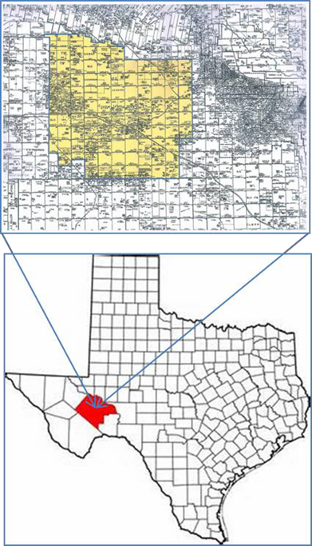
OVERVIEW: JILPETCO OPERATING
Wholly Owned Subsidiary
Jilpetco is a wholly owned oilfield services company that owns and operates drilling, completion, workover rigs and lease operational services equipment
Only services Amazing Energy and related parties
Positive Synergistic Effects From Jilpetco Acquisition
Created an all costs reduction
Improved efficiency and capability to drill new wells
Talented and experienced staff added to Amazing’s operations
Near Term Growth
Jilpetco is expected to grow at the same rate as the Pecos County operations
Notable Assets
Multiple rigs, trailers, trucks, cat grader and a backhoe loader
Minimal office and tech equipment needed to operate
Standby equipment for all operational needs
8

Slide 9
OVERVIEW: NAVIGATING THE STATUS QUO
Focused on building a healthy balance sheet, ample liquidity, and expected returns:
2018/2019 budget focused on balance sheet and E&P returns while creating significant future value
Drilling costs covered with strategic JV drilling partnerships and leveraging well ownership for currency and best cost case for growth through the drill bit
Expect to exit 2018 with manageable friendly debt held by Founder with no dependence on equity dilution to make debt payments
Highly concentrated acreage position in some of the most economic areas of the state of Texas:
Core Locations: 100+ net undeveloped wells
Resilient Economics: Drill costs covered entirely by partners while cashflows from success will be shared
Continual scientific development for best well cost management and development of a manufacturing style drilling plan
Compelling Returns in challenging market: Permian Basin provides some of the best economics industry wide with Amazing taking advantage of lower than average land and acquisition costs due to rights held.
9

Slide 10
OVERVIEW: WHY INVEST IN AMAZING?
100% of leasehold in attractive, Texas-based locations
Differentiated technical and geological approach has led to attractive modeled returns
Conservative financial approach to development and well manufacturing mode
Incentivized management team
Ability to grow quickly with low CAPEX requirements protects shareholder value
Minimal dilution risk
Well prepared to operate in the “new normal” status quo
10

Slide 11
OVERVIEW: MANAGEMENT’S “CHECKLIST”
Execute liabilities reduction and management program; stabilizing balance sheet
Raise D&C CAPEX and successfully D&C WWJD #23, WWJD #31, and WWJD #30 well
Institute new accounting system; secure new transfer agent; complete 10-K filing on time
Secure new Engineering, Geology, and Landman teams; hire COO/CFO
Raise CAPEX to D&C first horizontal San Andres well in Pecos County
Further develop producing leases and apply new science to unlock potential that exists behind the wellbore and in existing producing wells/formations
Drill 11 new “directional” laterals
Perform an open hole completion on the #30 well and spud/drill the #31 horizontal San Andres well
Execute on two 5 spot waterflood pilots first quarter of 2019
11

Slide 12
PECOS COUNTY
PRIME ASSETS IN A PRIME BASIN
12

Slide 13
OVERVIEW: PECOS COUNTY
Primary Location
Central Basin Platform between the Midland and Delaware Basins
History suggests vertical and horizontal potential from stacked pay zones
Operations in Pecos County
Over 1,800 oil and gas producing leases, ~200 licensed operators and over 20,600 drilled wells
Offset operators include Concho, Apache, Pioneer, Diamondback, Occidental Petroleum, Kinder Morgan and Jagged Peak
Adjacent Fields – Over Two Billion Barrels Total
Yates Field – Over 1.6 billion barrels of oil produced
Walker Field – Over 10 million barrels of oil produced
Taylor Link Field – Over 17 million barrels of oil produced
Amazing’s Position
Account for rights within 70,000 acres lease hold (approx. 100 sq. miles), 100% Working Interest, 75% Net Revenue Interest
A total of 26 wells have been drilled on the property that are either producing or in the process of being completed
Lifting Cost is less than $10 per barrel
Potential Drilling Locations
Approximately 3,500 potential drilling locations in a single Queen Sand Bench with multiple benches on each for over 20,000 potential well locations
13

Slide 14
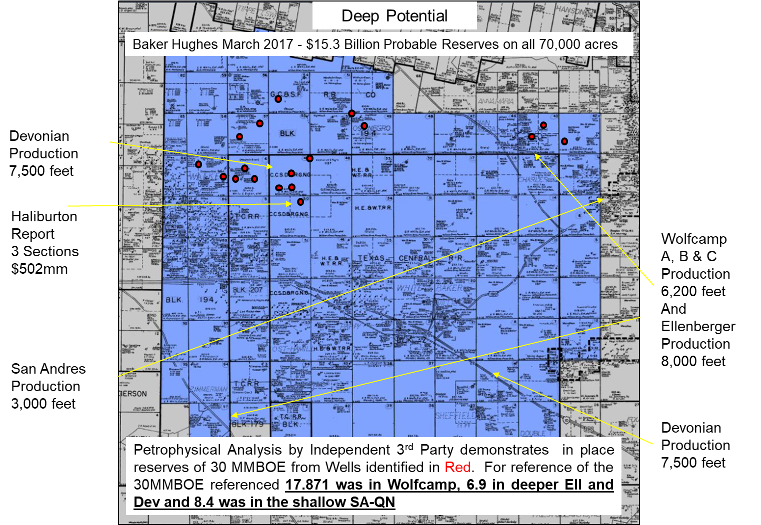
UNLOCKING VALUE: PECOS COUNTY
14

Slide 15
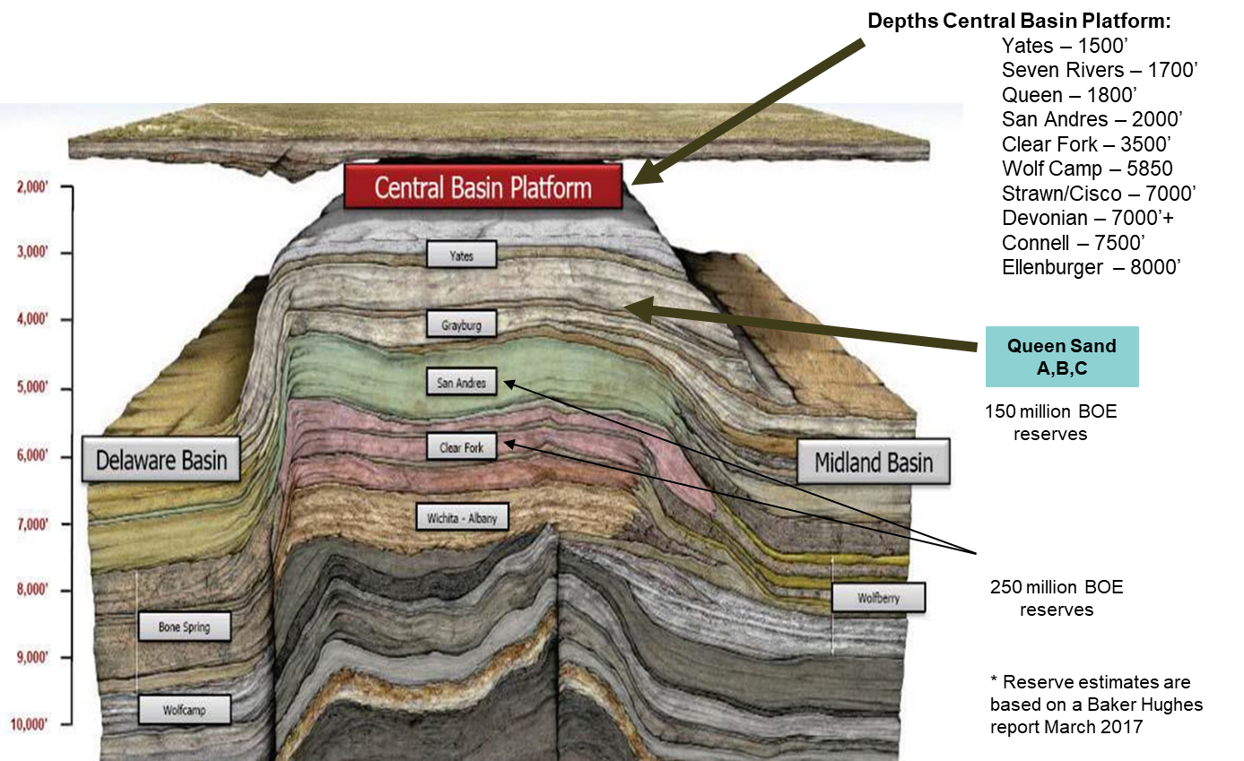
STACKED PAY ZONES: PECOS COUNTY
15

Slide 16
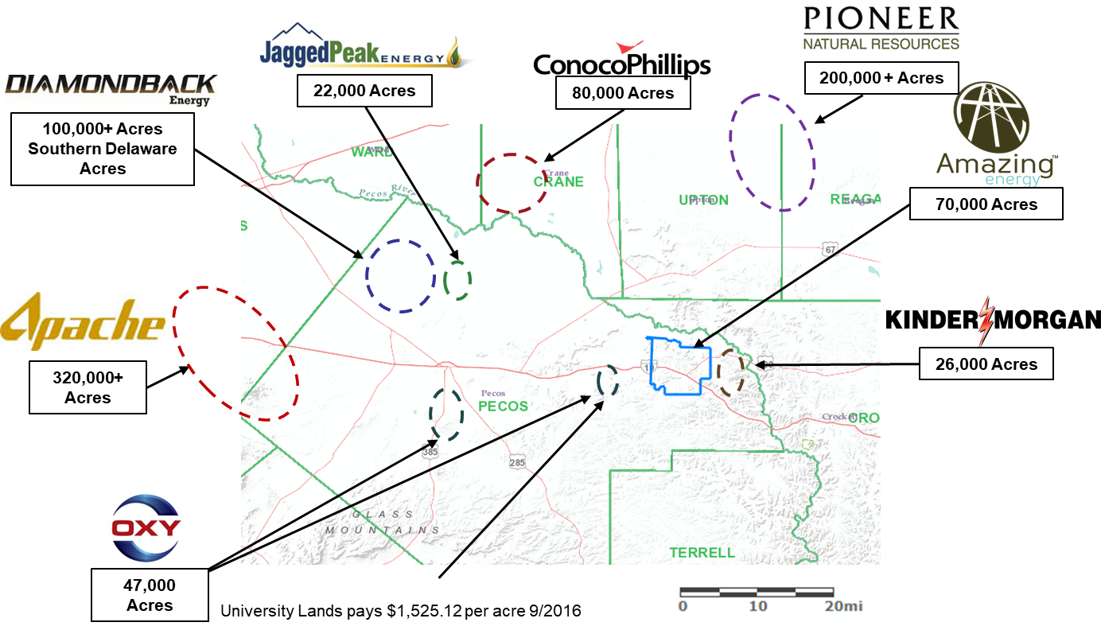
OFFSET OPERATORS: PECOS COUNTY
17

Slide 17
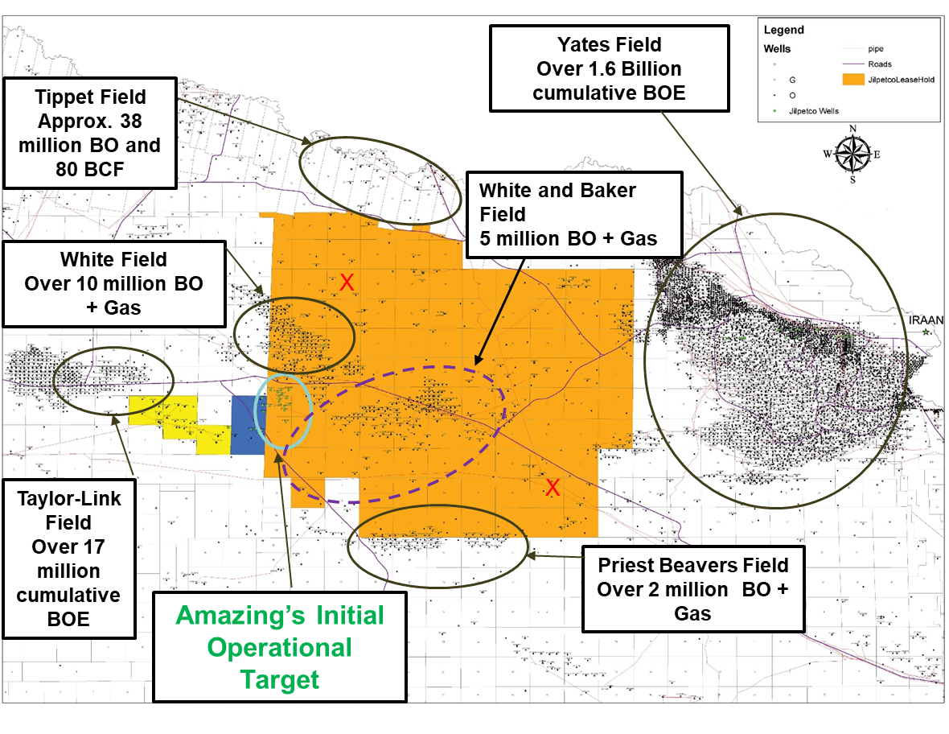
CONTIGUOUS ACREAGE: PECOS COUNTY
NOTE:
(1) “X” are Devonian Wells approximately 7,500 feet
(2) All black dots are/where successful oil producing wells
16

Slide 18
ECONOMICS AND DEV ELOPMENT SCHEDULE
Company cost to drill and complete 2000’ well - $200,000 per well
25 bopd x $45 per barrel x .93 taxes x 30 days in month x NRI .75 = $23,540/ well minus operational cost ($1,000 per well) for net revenue = $22,450 per month per well
Return of capital – approximately 8.9 months at $45 oil prices
15 bopd x $45 per barrel x .93 taxes x 30 days in month X NRI .75% = $14,124 minus operational cost ($1,000) for a net revenue= $13,124/ month per well
Return of capital – approximately 15.2 months at $45 oil prices
Not counting any tax advantages
Two vertical wells drilled every month and one horizontal well drilled every three months
Four vertical wells and one horizontal well drilled every month
18

Slide 19
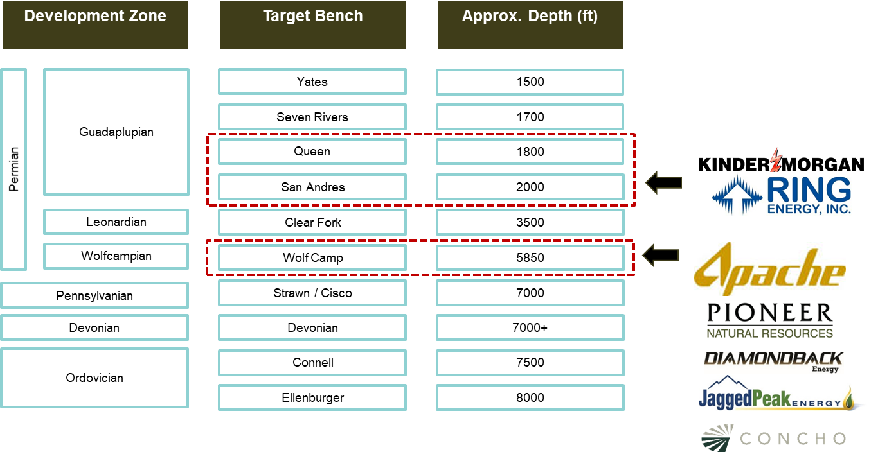
DEVELOPMENT POTENTIAL: PECOS COUNTY
19

Slide 20
MANAGEMENT
EXPERIENCE TO LEAD THE WAY
20

Slide 21
MANAGEMENT : AMAZING ENERGY
CEO
CFO
COO
WILLARD MCANDREW III
MARTY DOBBINS
DAVID ARNDT
47 years of experience in the oil and gas industry from field operations to refining to management
Has held positions at prominent oil and gas companies including Exxon (5+ years) and Hercules Oil
Served as COO and Director (3+ years) of Torchlight Energy a NASDAQ listed oil and gas E&P company
Ownership experience spanning prospect acquisitions to drilling and/or recompleting hundreds of wells
Attended Louisiana State University and served honorably in the United States Marines Corps
More than 45 years of corporate and financial management experience
CEO and President of InFocus Capital Advisors, LLC, guiding companies into new markets
CEO and President of Franskill, a consulting firm specializing in global expansion
Chief Global Investment Analyst with Motorskill Venture Group, LLC
Founder and Owner of CPA firm for 25 years
Over 50 years of operations, engineering and personnel management experience
Developed drilling programs and economic studies on exploratory and development projects in North Dakota, Mid-Continent, Texas, Gulf Coast, SE Asia and in the Middle East
Held senior positions at multiple energy companies including Torchlight Energy Inc., Conoco, Scotia Group, Sundance Resources and Petrosearch Energy Corporation
22

Slide 22
CONSULTANTS: AMAZING ENERGY
M&A Manager
Land Manager
Geologist
C. P. Geologist /
P. Geoscientist
JED MIESNER
LUCAS KNICKERBOCKER
BRUCE MILLER
Founded Amazing Energy in 2008 and Jilpetco in 2002
Worked for Exxon USA for 13 years
Formed his own oil and gas company in 1994 called L&R Energy Corporation
Involved in drilling projects throughout Texas and Oklahoma
More than 20 years of leasing approximately 500,000 acres in 6 states
He has worked every major oil and gas basin in the U.S. for companies ranging from private equity to public companies
Has been instrumental in activities of over 1,000 wells
Has participated in over 200 wells personally
His experience with all activities from leasehold to production
BORIS P. ABAD-GUERRA, MS, PHD
Over 40 years Oil and Gas industry experience
Attended Penn State on the Fulbright and LASPAU scholarships, PhD Program sponsored by Penn State
Experienced in scientific and economic analysis, oil and gas prospect and project evaluation, design and implementation of water-flooding and EOR, oilfield operations, training technical teams, government, national and private oil company negotiations
Over 35 years experience in Geology
Worked for Exxon Production Research in South Texas, the Permian Basin, the Rockies and Alaska
Extensive experience in Permian Basin geology including extensive digital database build
Experience in multi-well drilling programs in Texas and New Mexico, Petra mapping, data base, 2-D/3-D seismic interpretation software, and production and scout data
21

Slide 23
CONTACT US: INVESTOR RELATIONS
Get in Touch
Investor Relations Contact
Derek Gradwell MZ Group SVP Natural Resources Phone: 512-270-6990 Email: dgradwell@mzgroup.us

